Slide 1
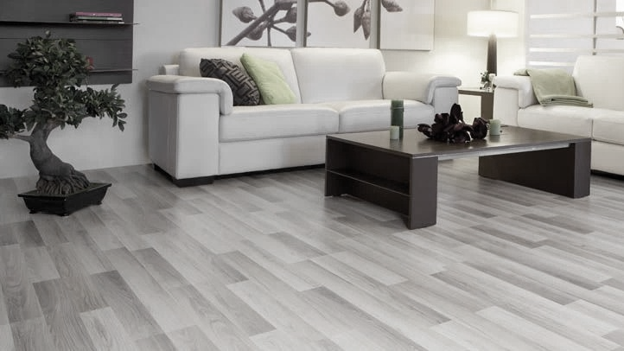
Shchekinsky
Linoleum

Slide 2
ABOUT THE COMPANY
Shchekinsky Linoleum OOO is a commercial company specializing in the production of heat-and-sound insulating linoleum. We use our wealth of experience, knowledge and professionalism to offer our buyers quality products that have been approved with all the required certificates. We promote
the use of new technologies and improvements in the products we manufacture. Major Russian and international companies choose us to provide linoleum because of our financial growth, production potential, and the orderly work of our professionals.
These competitive advantages allow us to fulfill
the tasks we are given, put our ideas and knowledge into practice, and achieve our goals.

Slide 3
THE HISTORY OF THE COMPANY
11
November 2017
01
February 2006
The entry into force of the new
GOST 18108-2016
Located at the linoleum production base of Khimvolokno OAO, Shchekinsky Linoleum OAO was founded to deal in the manufacture and sale of residential-grade linoleum.
02
10
April 2015
April 2007
Release of GOST 18180-80-compliant linoleum.
Participation in the BATIMAT RUSSIA 2015 international construction and interior design exhibition at the Crocus Expo international exhibition center in Moscow.
03
June 2008
12
June 2019
Participation in the Low-rise Construction, Progressive Construction Technologies and Materials exhibition in the Tula kremlin, Tula.
Golden quality mark

Slide 4
WHY CHOOSE US?
We are always expanding our product range
We are the manufacturer
We have experienced staff
We manufacture
high-quality products
We operate throughout Russia, the CIS, Asia
and Europe
We respect our clients
and uphold our reputation

Slide 5
LINOLEUM
Builder TU
EKONOM TU is a collection of residential-grade linoleum for various types of flooring in the economy segment, with a thickness of 2.0 mm. It offers a wide range of different designs in widths from 1.5 m to 4.0 m, with a wear-layer of 0.15 mm (1.5 m/2.0 m) and 0.15 mm (2.5 m/3.0 m/3.5 m/4.0 m).
Structure of covering
Range of uses
For flooring in living, public and industrial spaces.
1
2
3
4
1. PVC protective layer
3. Filled PVC layer
2. Patterned layer
4. Nonwoven heat-bonded fabric

Slide 6
LINOLEUM
BUSINESS TU
BUSINESS TU is a collection of residential-grade, 2.5 mm-thick linoleum. In terms of price and quality, it is the ideal choice of flooring for repairing your space. The range of widths of this collection is between 1.5 m and 4.0 m, with a 0.15 mm wear-layer (1.5 m/2.0 m) or 0.15 mm (2.5 m/3.0 m/3.5 m/4.0 m). This linoleum is designed for flooring in living, public and industrial spaces.
Structure of covering
Range of uses
For flooring in living, public and industrial spaces.
1
2
3
4
1. PVC protective layer
3. Filled PVC layer
2. Patterned layer
4. Nonwoven heat-bonded fabric

Slide 7
DESIGNS IN THE Builder TU/ BUSINESS TU/ Optima TU COLLECTION
Borei 1
Borei 2
Germes
Fobos
Orphei
Nika
Tira
Vega 2
1.5 m
1.5 m
1.5 m
1.5 m
1.5 m
1.5 m
1.5 m
1.5 m
2.0 m
2.0 m
2.0 m
2.0 m
2.0 m
2.0 m
2.0 m
2.0 m
2.5 m
2.5 m
2.5 m
2.5 m
2.5 m
2.5 m
2.5 m
2.5 m
3.0 m
3.0 m
3.0 m
3.0 m
3.0 m
3.0 m
3.0 m
3.0 m
3.5 m
3.5 m
3.5 m
3.5 m
3.5 m
3.5 m
3.5 m
3.5 m
4.0 m
4.0 m
4.0 m
4.0 m
4.0 m
4.0 m
Argo 1
Argo 2
Dorado
Irida
Antila
Kanter
Leo
Hector
1.5 m
1.5 m
1.5 m
1.5 m
1.5 m
1.5 m
1.5 m
1.5 m
2.0 m
2.0 m
2.0 m
2.0 m
2.0 m
2.0 m
2.0 m
2.0 m
2.5 m
2.5 m
2.5 m
2.5 m
2.5 m
2.5 m
2.5 m
2.5 m
3.0 m
3.0 m
3.0 m
3.0 m
3.0 m
3.0 m
3.0 m
3.0 m
3.5 m
3.5 m
3.5 m
3.5 m
3.5 m
3.5 m
3.5 m
3.5 m
4.0 m
4.0 m
4.0 m
Atlas
Mira
Kameya
Idalgo
Fenix
Gefest
Olimp
Pegas
1.5 m
1.5 m
1.5 m
1.5 m
1.5 m
1.5 m
1.5 m
1.5 m
2.0 m
2.0 m
2.0 m
2.0 m
2.0 m
2.0 m
2.0 m
2.0 m
2.5 m
2.5 m
2.5 m
2.5 m
2.5 m
2.5 m
2.5 m
2.5 m
3.0 m
3.0 m
3.0 m
3.0 m
3.0 m
3.0 m
3.0 m
3.0 m
3.5 m
3.5 m
3.5 m
3.5 m
3.5 m
3.5 m
3.5 m
3.5 m
4.0 m
4.0 m
4.0 m

Slide 8
CONTACTS
General director
Sergei Vadimovich Kunilov
+7(48751) 9-69-94
zll@azot.net
Commercial director
Sergei Anatolyevich Marinichev
+7(48751) 9-62-58 masa@azot.net
Head of Sales department
Sergei Nikolayevich Kozlov
+7(48751) 9-62-97 ksn@azot.net
Deputy Head of Sales
Zavyalova Natalya Anatolyevna
+7(48751)9-63-28
znan@azot.net
Cross-border logistics department (linoleum sales
in the foreign market)
Kosinova Olesya Evgenievna
+7(48751)9-69-84
koe@azot.net
301212 Tula Region, Shchyokinsky District workers’ settlement, 7 Simferopolskaya ul.

